Slide 1
Sales Data Analysis Project
Analyzing Revenue Drivers and Seasonal Sales Patterns

Slide 2
Problem Statement
Analyze sales data from 2023 to 2025 to identify key revenue drivers, seasonal sales trends, and top products/customers to support strategic decisions.

Slide 3
Data Cleaning Steps
Removed duplicate records
Standardized date and product category formats
Created calculated columns for categories
Validated sales and order data

Slide 4
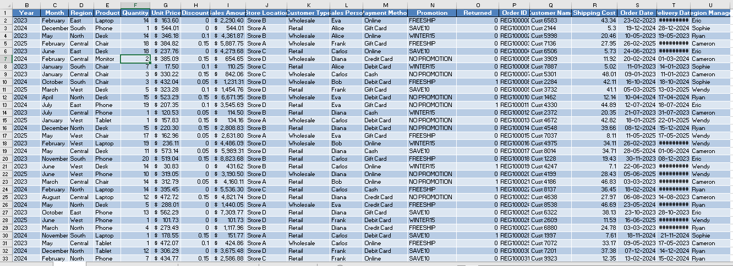

Slide 5

Key Performance Indicators (KPIs)
Total Sales: 4.38 Million
Total Orders: 1500
Average Order Value: 2.92K
Units Sold: 16K

Slide 6
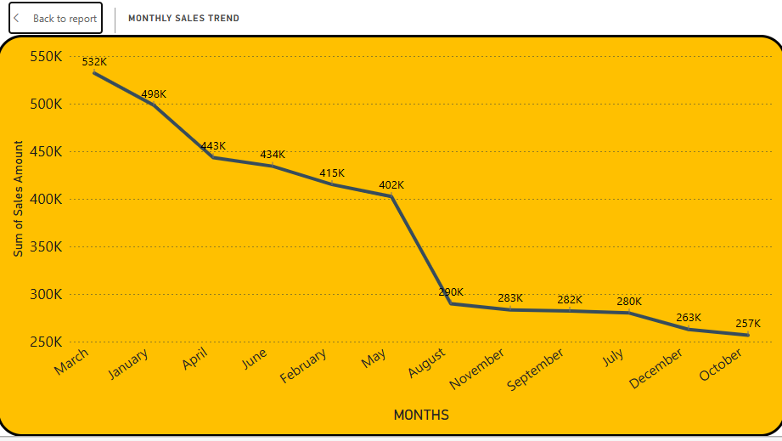
Top 3 Insights
North region generates the highest revenue.
Electronics category leads sales with over 2 million in revenue.
March is the monthly sales peak; early year stronger than later months.

Slide 7
Recommendations
Increase inventory and marketing before March peak.
Prioritize Electronics in promotional efforts.
Focus sales expansion in North region.
Develop customer loyalty programs.
Boost Furniture and Mobile Devices sales with promotions.

Slide 8
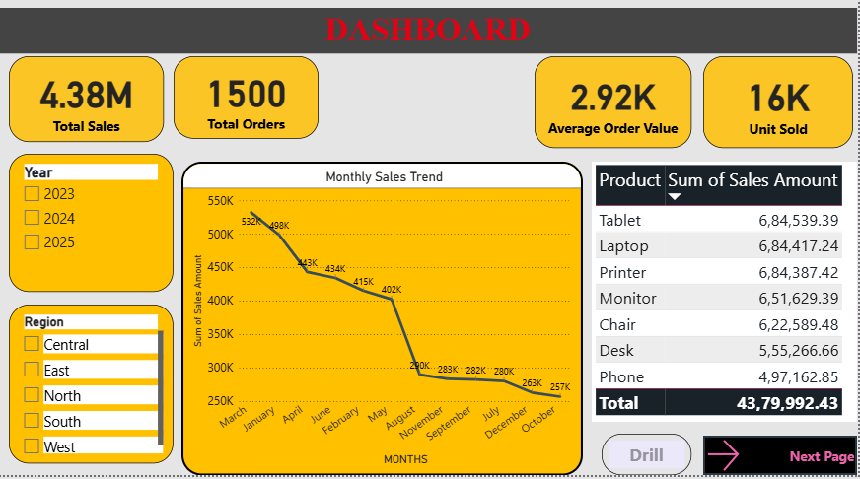
Conclusion
Insights provide guidance for growth through targeted resource allocation and marketing. Further analysis will fine-tune strategie

